Slide 1
ePMP 6GHz/5GHz AX update
September 28th, 2021

Slide 2
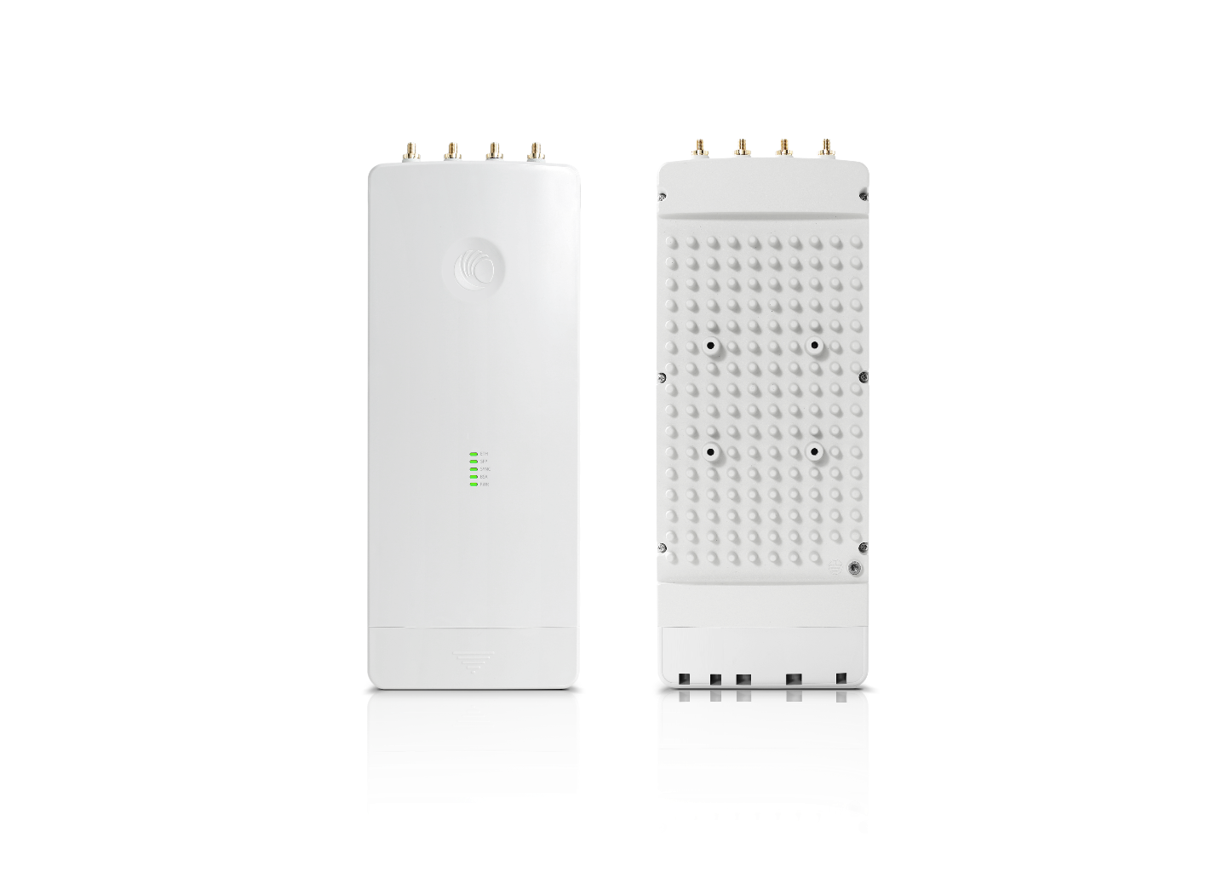
Why ePMP?
802.11ac Wave 2 for up to 5X performance
  4x4 MU-MIMO
  Wider Channels
  Higher Modulation
Leader in scalability and interference tolerance
  Uplink beam-steering and Dynamic Filtering
  Synchronization
Protects your investment
  Compatibility with 11n devices and Elevated devices
  Improved performance (LDPC and MRC)
Lowers TCO (Total Cost of Ownership)
  3-year hardware warranty
  Support direct from the channel and the supplier

Slide 3
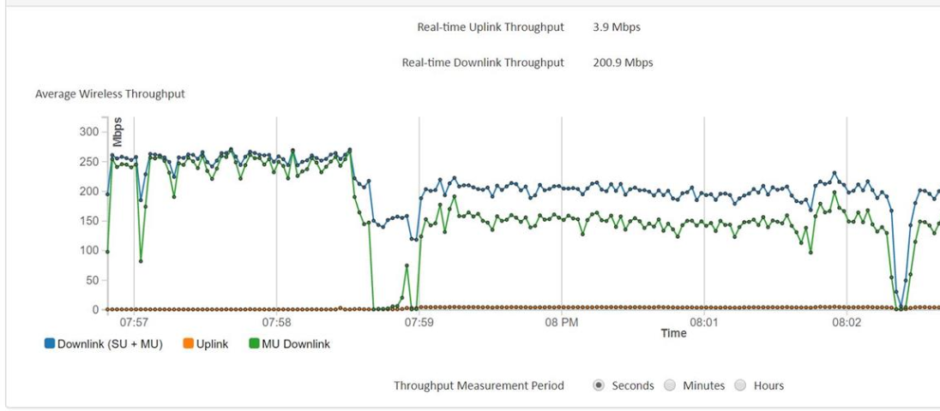
Why ePMP?
Longer term Cambium benefits
Investment protection and strategic benefits
Every AC SM you deploy today will be compatible with an 8X8 MU-MIMO AP. This ensures a path to higher order MU-MIMO systems. End result? More capacity in your network simply by swapping APs.
Cambium focus on MU-MIMO is following the trends set by IEEE, 3GPP and 5G. Multiple input/output systems and the ability to send/receive data is the only way to higher tput. Systems only supporting higher modulation will always be limited by noise/interference.
Cambium support at many levels. An engagement from a senior engineer is a forum post away or a quick escalation away.
A partnership at every level with 3 year warranties and a company willing to be by your side.
MU gain

Slide 4
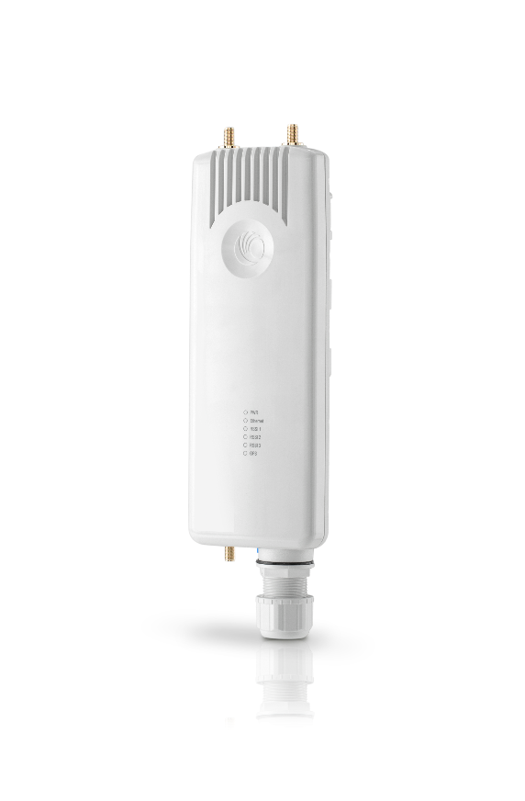
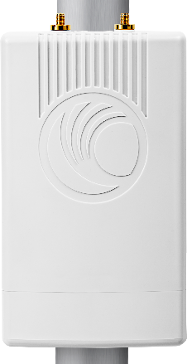
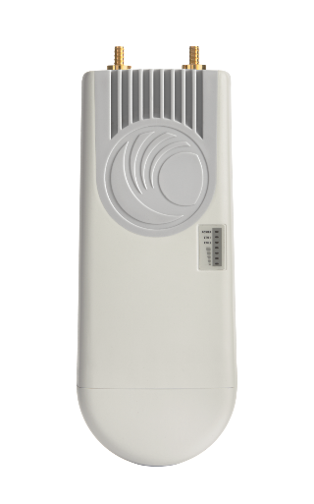
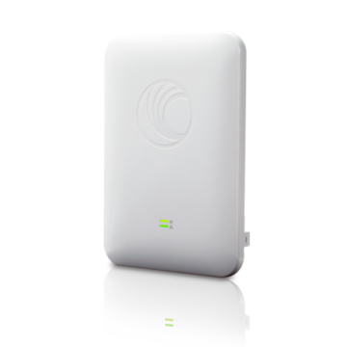
ePMP Portfolio – Access Points
ePMP 3000
5 GHz
4x4 MU-MIMO
802.11ac Wave 2
120 SM’s
Dynamic Filtering
Opt. UL Beam-Steering
ePMP 3000L
5 GHz
2x2 MIMO
802.11ac Wave 2
64 SM’s
ePMP 2000
5 GHz
2x2 MIMO
802.11n
Full (120 SM) or Lite (10 SM)
Dynamic Filtering
Opt. UL Beam-Steering
ePMP 1000
2.4, 2.5, 6.4 GHz
2x2 MIMO
802.11n
Full or Lite
Omni Micro-POP
5 GHz
2x2 MIMO
802.11ac Wave 2
CSML (ROW only)
5.15 to 6.13
2x2 MIMO
802.11AC
Non GPS AP
Licensable to 12 SMs

Slide 5
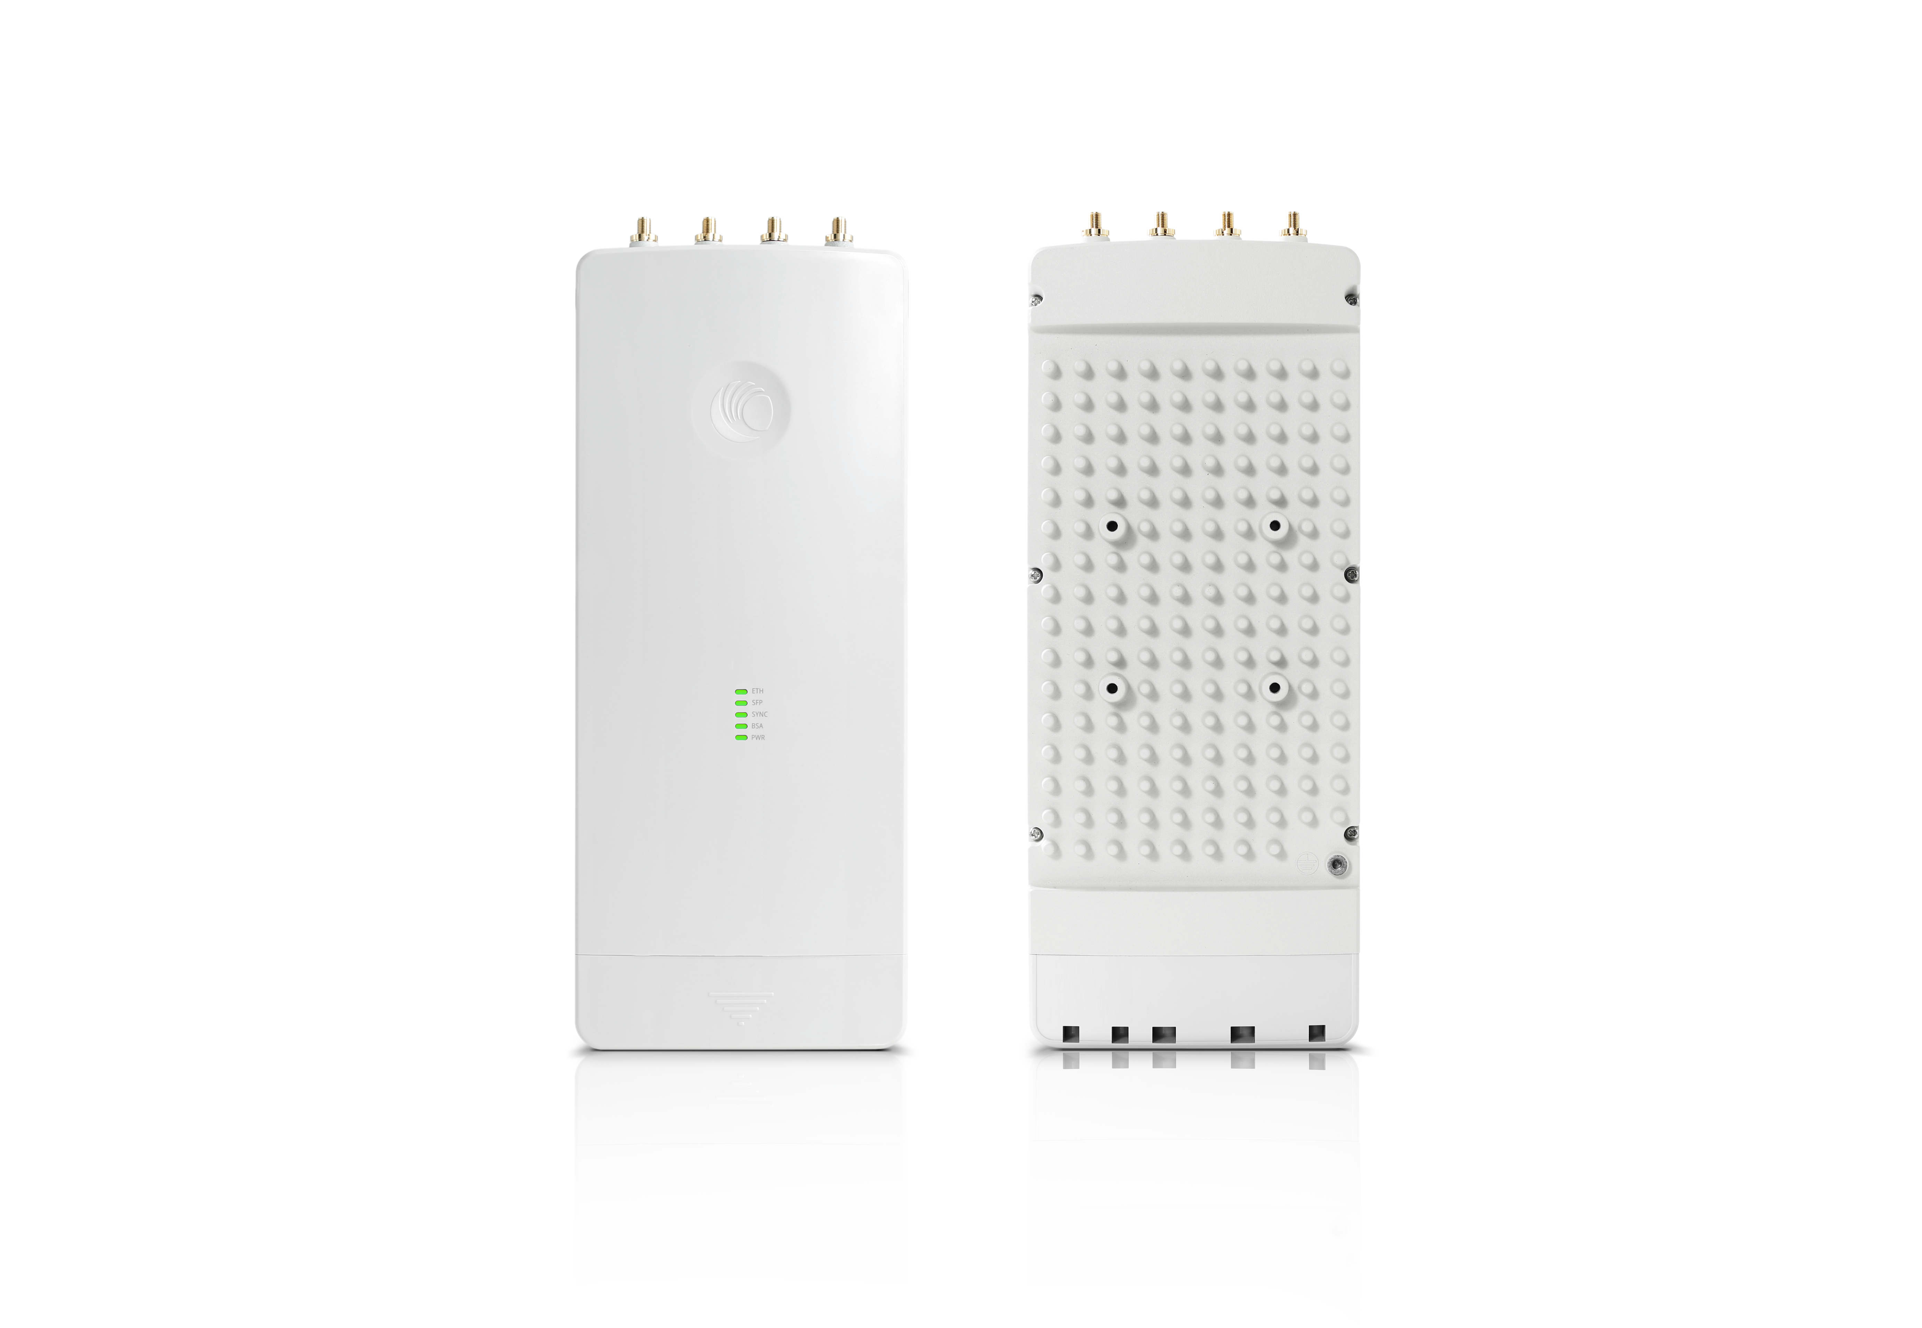
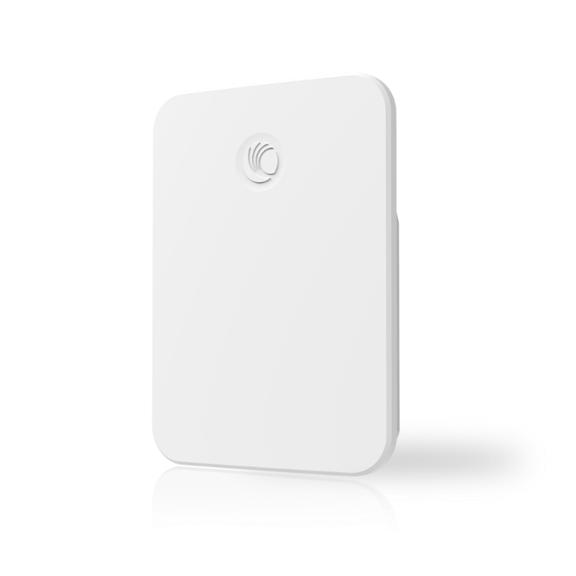
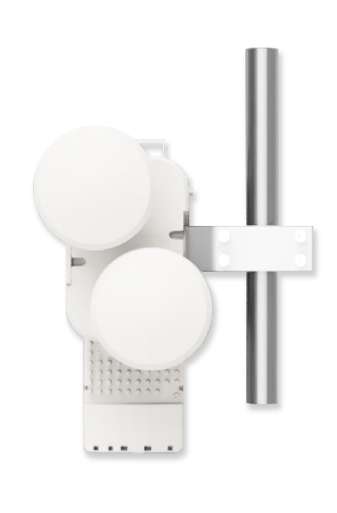
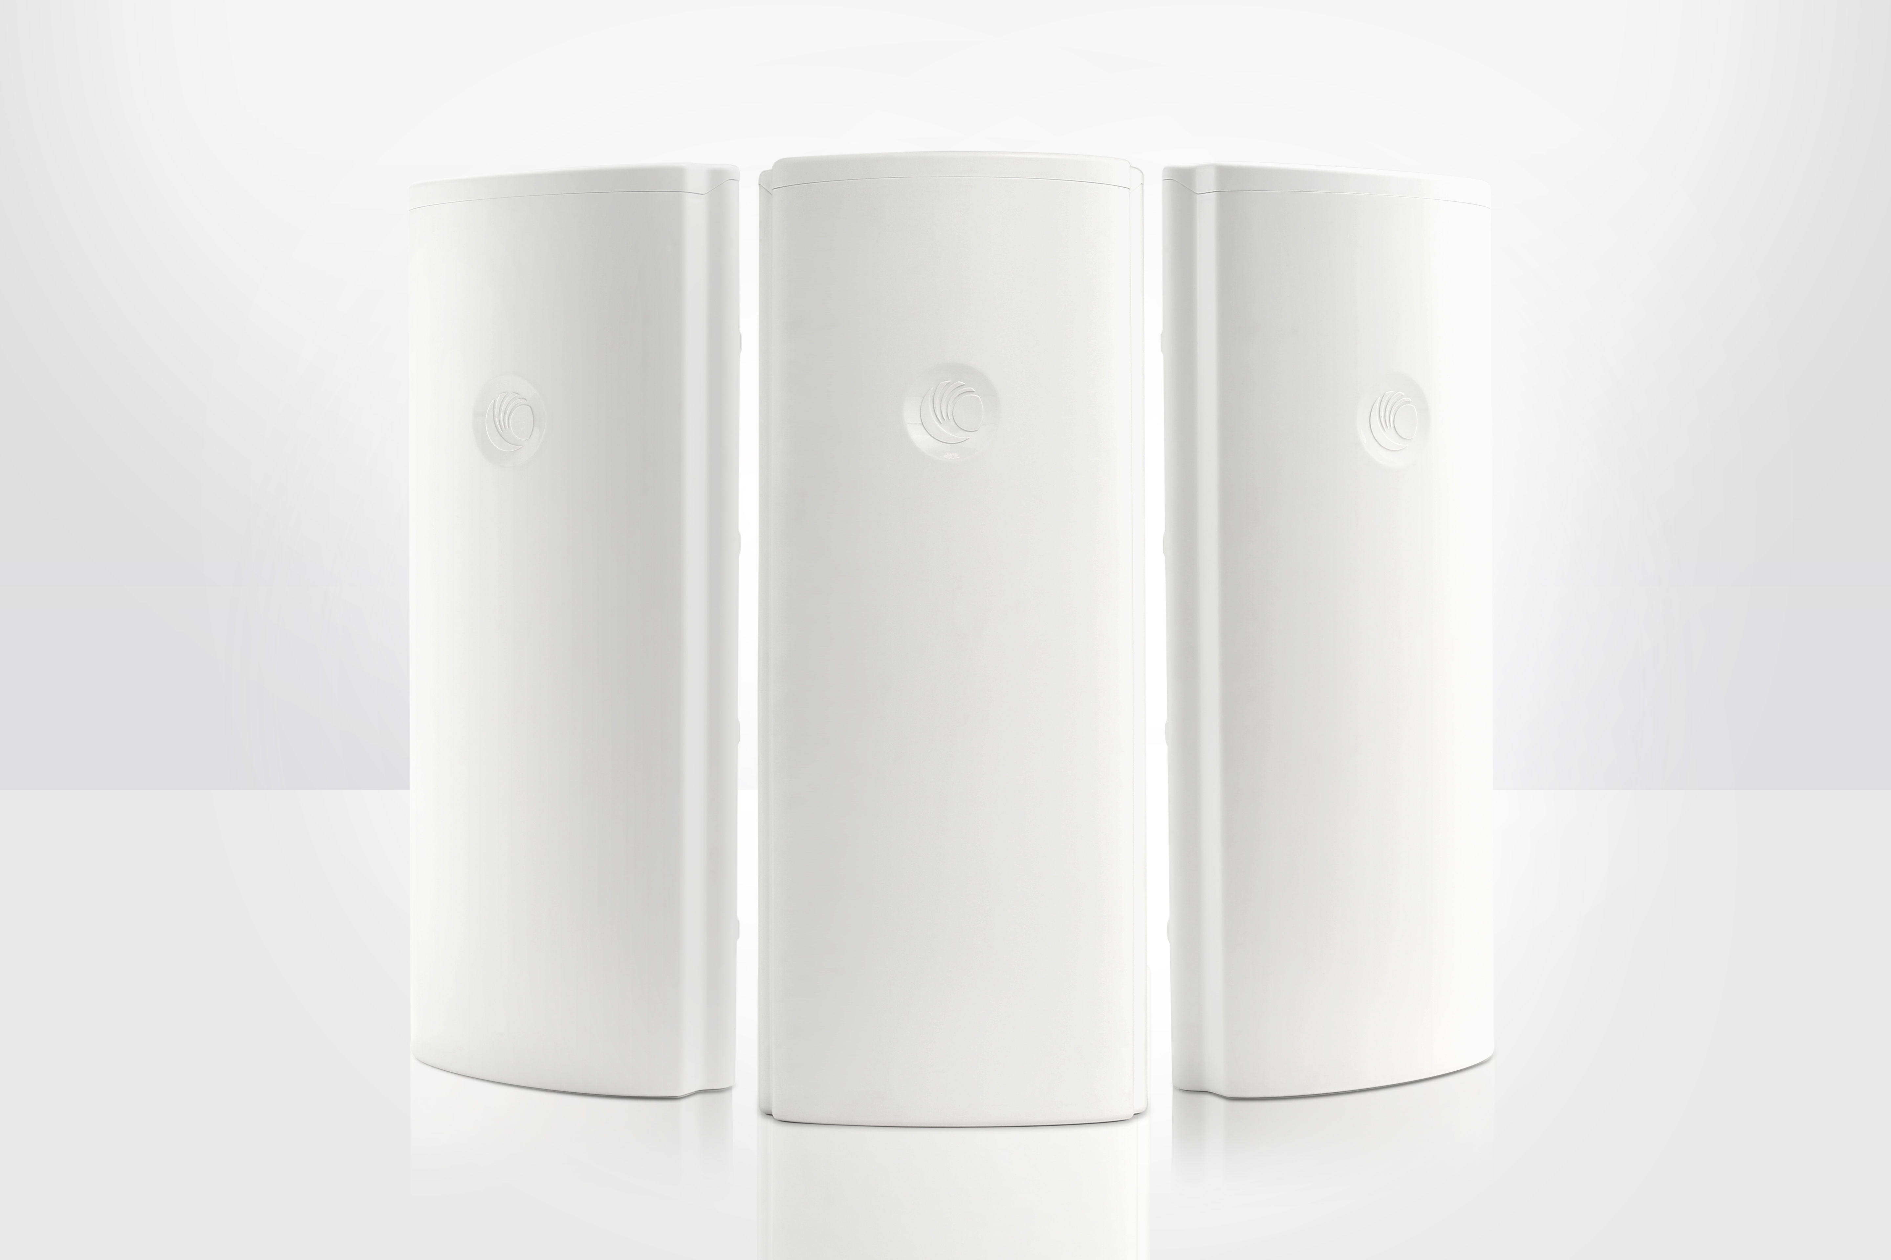
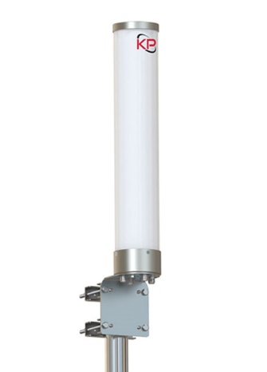
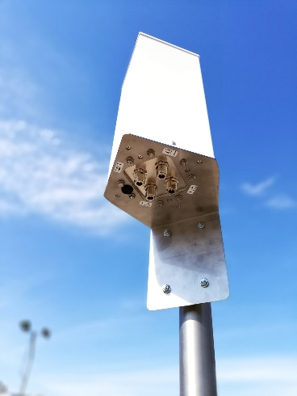
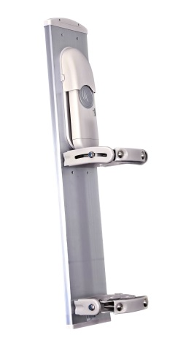
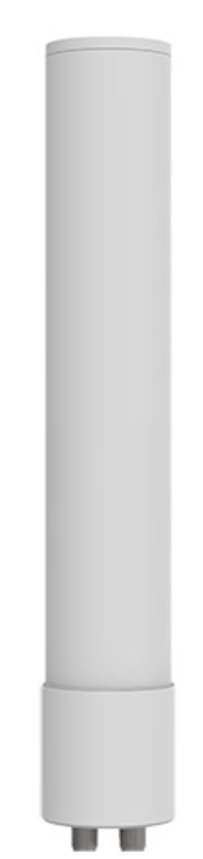
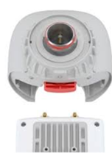
Access Point topologies to fit the Application
ePMP MicroPOP
ePMP 3000L
ePMP 3000
MU-MIMO
Sector
MU-MIMO Omni
KP Performance
MU-MIMO Omni
ITELite
MU-MIMO
Dual Horn
Sector
Omni
Twist-Port adaptor
RF Elements
Notes:
Shows flexibility of the portfolio and eco system development.

Slide 6
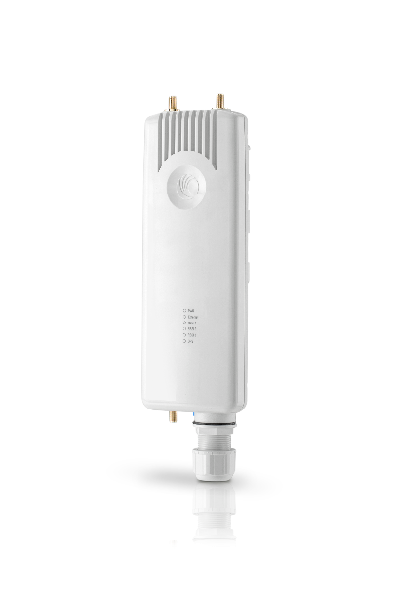
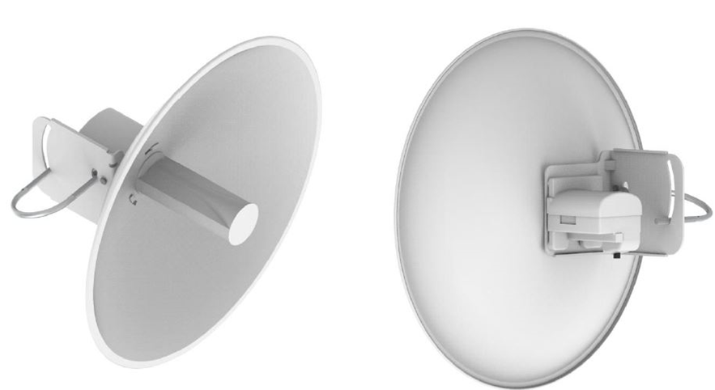
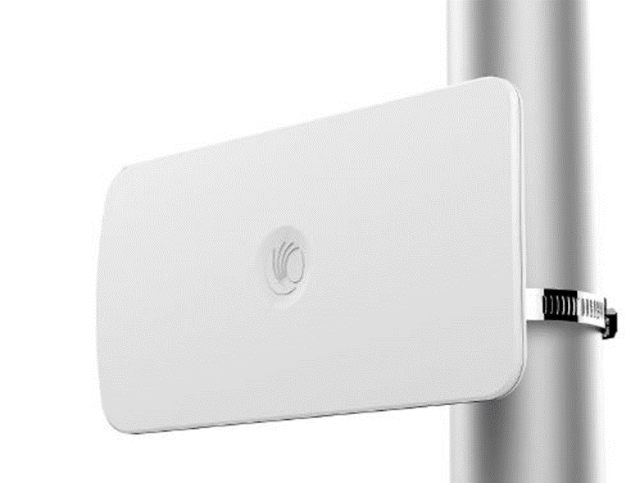
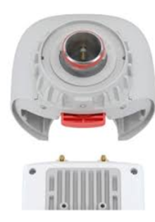
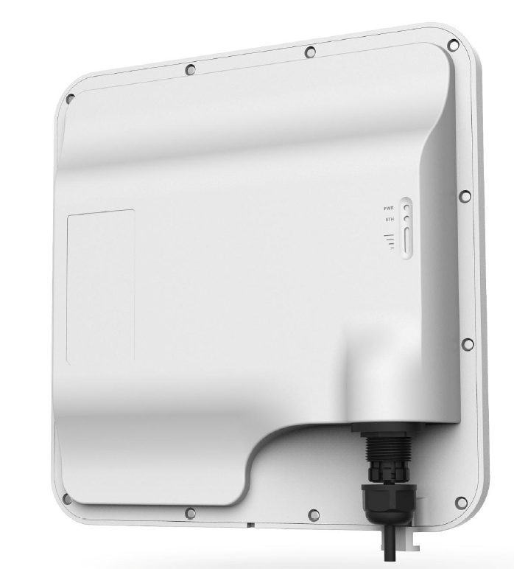
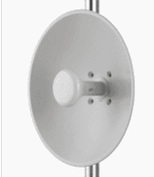
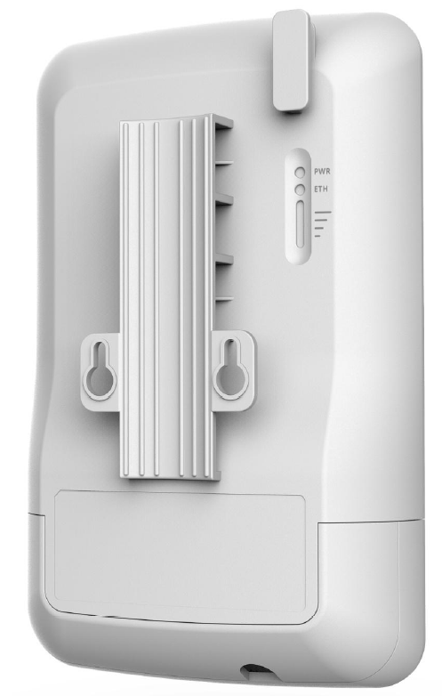
ePMP Force 300 (802.11ac Wave 2) Subscriber Module Portfolio
F300-25
25dBi gain
Gigabit Ethernet
Real time spectrum analyzer
F300-16
16dBi gain
Gigabit Ethernet
Real time spectrum analyzer
Small form factor
15 degree Azimuth/Vertical orientation
F300 CSM (IP67)
2X2 Wave 2 Connectorized SM
Support for external horns and dishes
F300-13L (IP55)
Low-Cost
2X2 Wave 2 SM
13dBi gain
Not available in N. America
F200L & 325L (ROW)
Low-Cost 11n & 11AC SM
4.9 to 6200
No dedicated SA
Peak tput @80 ~400Mbps
F300-19 (IP55)
2X2 Wave 2 SM
19 dBi gain flat panel antenna
F300-19R (IP67)
2X2 Wave 2 SM
19 dBi gain flat panel antenna
Adds 5/10 MHz channels
Enterprise SW Plan of Intent
F300-13 (IP55)
2X2 Wave 2 SM
13dBi gain

Slide 7
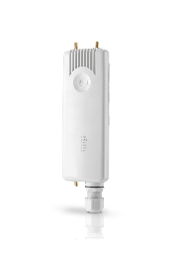
Force 300 Subscriber Module Portfolio Summary
 | 300-13L | 300-13 | 300-16 | 300-19 | 300-25 | 300-19R | 300 CSM
Form Factor | 13 dBi Panel | 13 dBi Panel | 16 dBi Panel | 19 dBi Panel | 25 dBi Dish | 19 dBi Panel | Connectorized
Applications / Key Features | Short-range SM or PTP Not available in N.America sales region | Short-range SM or PTP | Mid-Range SM or PTP | Mid-Range SM or PTP | Long-Range SM or PTP | Mid-Range SM or PTP + 5/10 MHz PTP + Enterprise features (256AES, SNMPv3) + 4.9 GHz FCC | Long-range SM or PTP Twistport compatible
IP Rating | IP55 | IP55 | IP55 | IP55 | IP55 | IP67 | IP67
All support:
802.11ac Wave 2
20/40/80 MHz channels up to 256QAM
600 Mbps max capacity (300-13L = 400 Mbps)
Synchronization with appropriate AP
Compatible with ePMP 3000, 3000L, 2000 and 1000 Access Points
LINKPlanner
cnMaestro
cnHeat

Slide 8
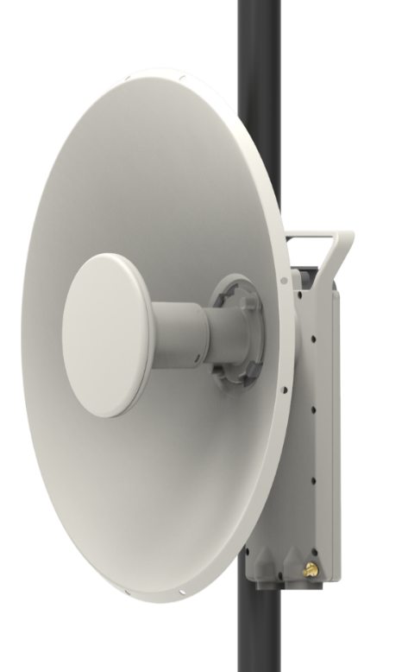
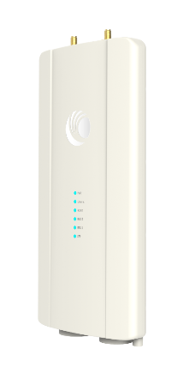
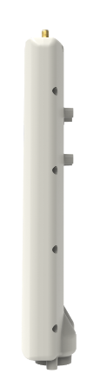
Introducing the ePMP Force 425 and Force 400C
Industry first proprietary point to point product based on 802.11ax
Gigabit Performance
Last-mile Fiber alternative
Target Markets / Applications
  High-capacity Enterprise point to point
  Low-cost WISP back-haul
  GPON last mile
Key Specifications
  Up to 1Gbps usable throughput
  Sub 5 ms latency
  4.9 to 6.135 GHz – an additional~230MHz for ROW!
  25 dBi integrated dish (optional 28 dBi range extender - a first for Cambium)
  IP67 Ruggedization
  GigE and SFP port (optional GPON module – a first for Cambium)
Force 400C
Force 425

Slide 9

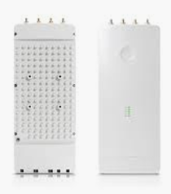
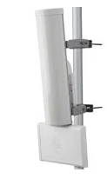
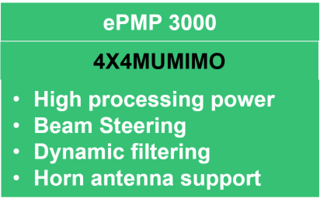
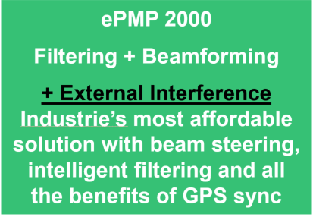
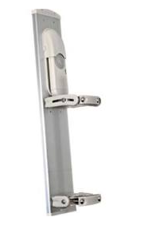
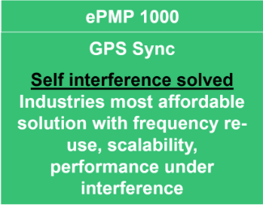
ePMP Evolution
Multi Gbps
w/ 8X8 MU-MIMO
1024 QAM / 160 MHz
5 GHz and 6 GHz
Compatibility to 11ac/11n
>1 Gbps
w/ 4X4 MU-MIMO
256 QAM/80 MHz
Compatibility to 11ac in 11n + mode
Mbps/$
802.11ax
8x8 MU-MIMO
OFDMA
Multi Gigabit PMP
Gigabit PTP
Interference mitigation
200+ Mbps
w/Interference Mitigation
Backwards compatible SMs
Mbps/$
200+ Mbps
Performance
Notes:
Could be last slide hinting at the roadmap without committing to it.

Slide 10
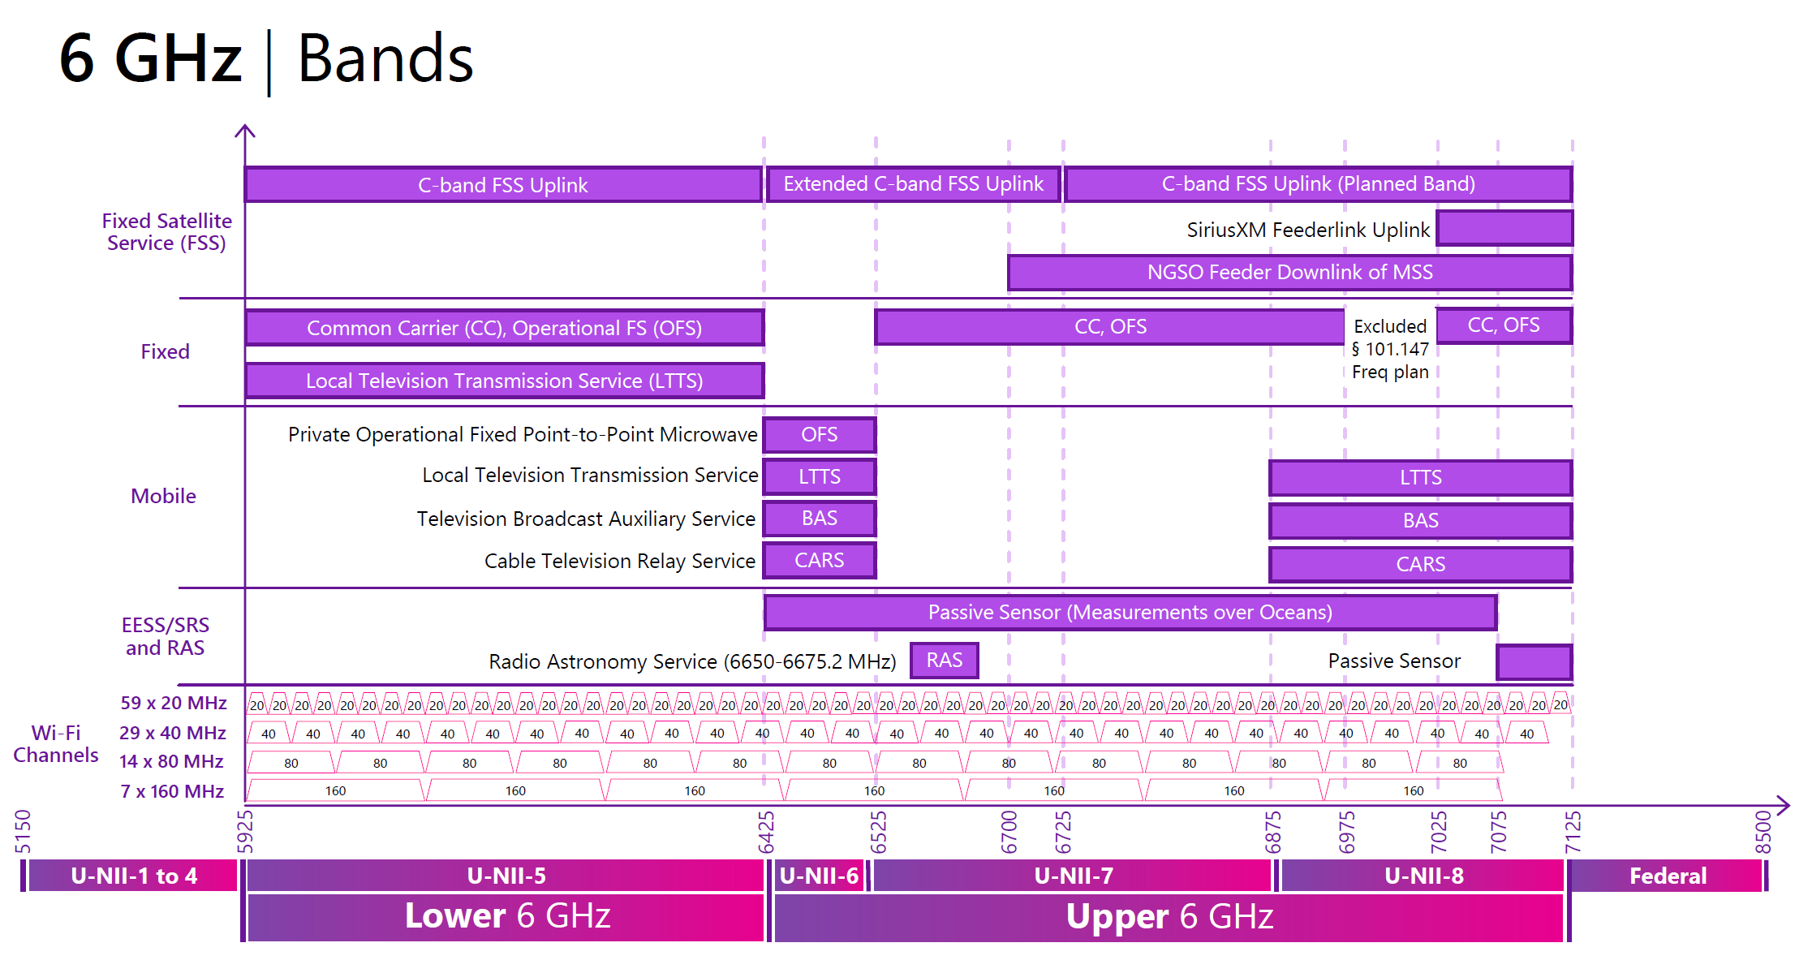
6GHz Band
Notes:
Could be last slide hinting at the roadmap without committing to it.

Slide 11
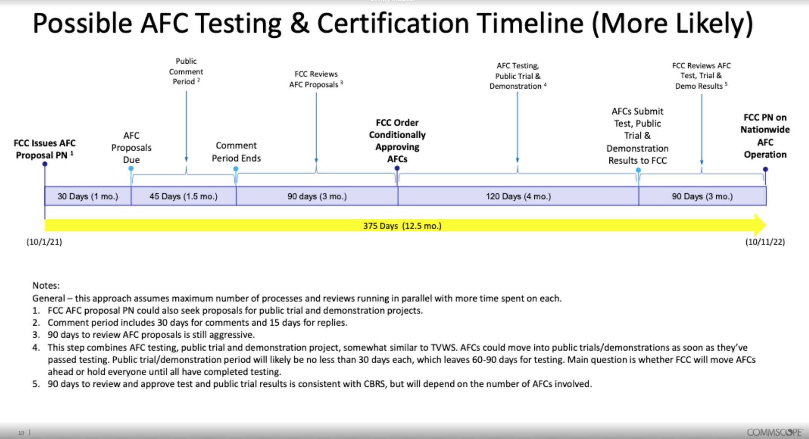
Possible timeline

Slide 12
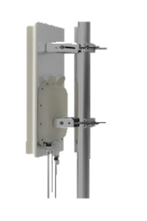
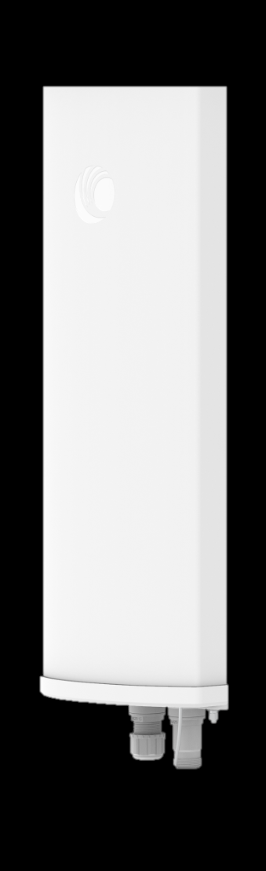
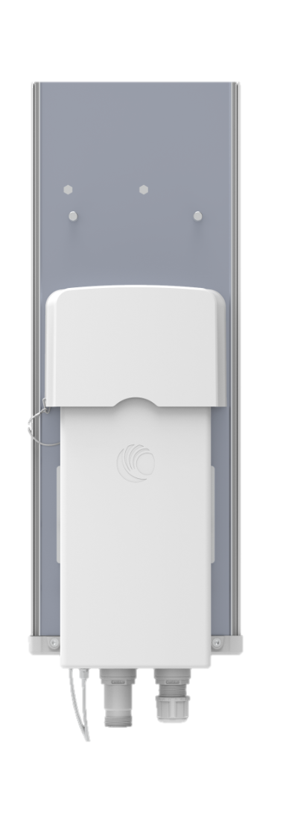
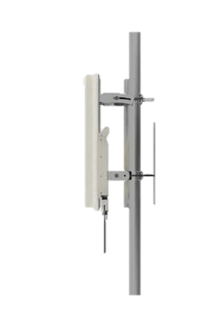
ePMP WiFi 6 Access points - ePMP 4000
8x8 5GHz AP
4x4 6 GHz AP
Features
Integrated 8x8 Sector Antenna
Freq Support 4.9 - 6.135 GHz
48V PoE/ and 4 wire DC in
SFP+ interface
IP67
636 mm x 485 mm
80 MHz Ch, 1024 QAM
TX Power 25 dBm/Chain
Features
4x4 6 GHz sector antenna
Freq Support 5.9 - 7.250 GHz
48V PoE in
SFP+ interface
IP67
Radio – 235 mm x 125 mm, Antenna 594 mm x 157 mm
160 MHz Ch, 4096QAM support
TX Power 24 dBm/chain

Slide 13
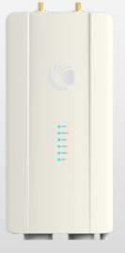
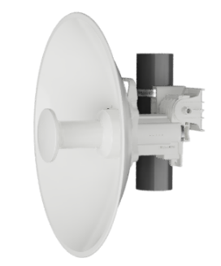
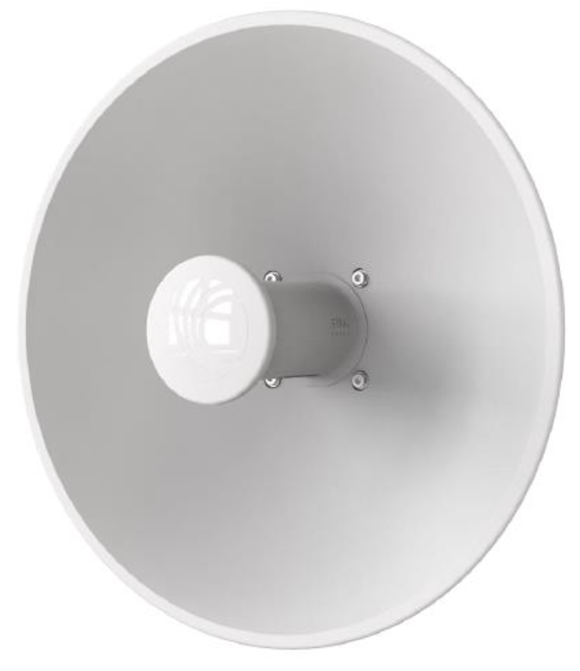
ePMP Force 400 Subscriber Modules
6 GHz PTP/SM
6 GHz SM
5 GHz SM
5 GHz SM (ROW)
Features
Supports RFE Twistport
Freq Support 5.9-7.250 GHz
48V Active PoE in
SFP+ interface
IP67
256 mm x 125 mm
160 MHz Ch, 4096 QAM
TX Power 24 dBm/Chain
Internal GPS
Features
25 dBi Antenna
Freq Support 5.9-7.250 GHz
48V Passive PoE in
IP55
450 mm Diameter
160 MHz Ch, 1024 QAM
TX Power 24 dBm/Chain
USB GPS Accessory
Features
25 dBi Antenna
Freq Support 4.9 -5.9 GHz
48V Passive PoE in
IP55
450 mm Diameter
80 MHz Ch, 1024 QAM
TX Power 25 dBm/Chain
Features
25 dBi Antenna
Freq Support 4.9 -5.9 GHz
30V Passive PoE in
IP55
450 mm Diameter
80 MHz Ch, 1024 QAM
Peak tput of 400Mbps
TX Power 25 dBm/Chain

Slide 14
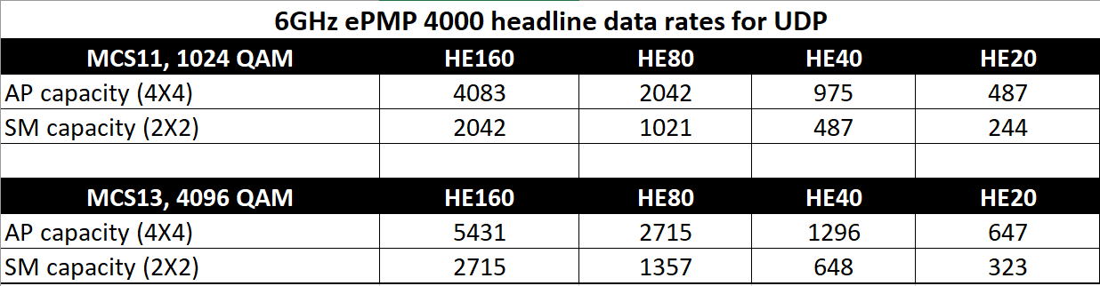
6 GHz ePMP 4000 Specifications
Hardware Specs
Proven ePMP Air Interface
Qualcomm 802.11ax family of chipsets
4x4 MU-MIMO AP w/ 90 degree beamforming sector
6 GHz band: 5.925 – 7.125 GHz
20 / 40 / 80 / 160 MHz channel bandwidth
1024QAM / 4096QAM
  4096 QAM proprietary mode w/ high-tier SM
Ethernet ports:
  1G RJ-45
  10G SFP+ for AP and F600C
PoE IEEE 802.3at – 56V
  30W - AP and F600C; 15W - SM
GPS on AP: built in and external
Optional external GPS Rx on SM to comply with AFC
Performance Specs
Concurrent 4x4 MU-MIMO & DL/UL OFDMA
  Double spectrum efficiency with MU-MIMO
  OFDMA efficiently uses bandwidth for short transmissions
Higher efficiency of AX with less overhead (shorter guard intervals)
3 QoS Levels: VoIP, High & Low
Priority-based air-fairness scheduling with starvation avoidance.
TDD scheduling with GPS Sync
  5 & 2.5 ms frame duration
  Flexible duty cycle (DL/UL) from 75/25 – 30/70 with 5% step.
TDD Scheduling w/o GPS sync:
  Flexible frame duration
AFC support based on GPS/GNSS geolocation.
ACS (Automatic Channel Selection)

Slide 15
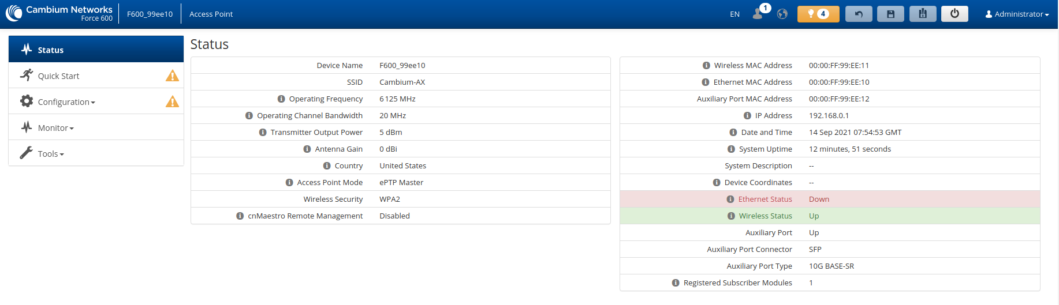
20 MHz channels, device configs: AP

Slide 16
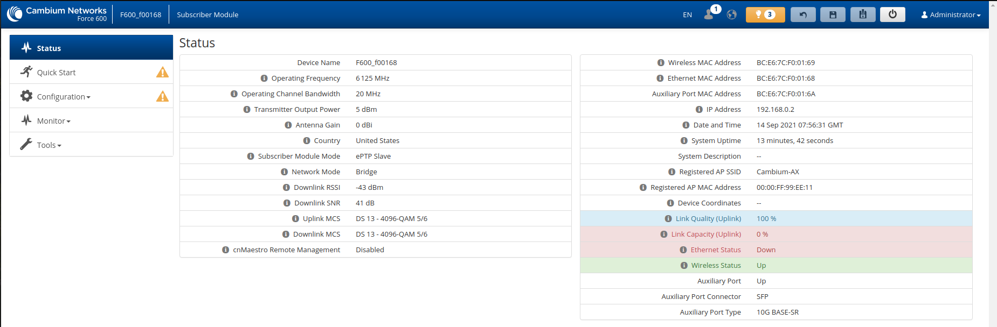
20 MHz channels, device configs: SM

Slide 17
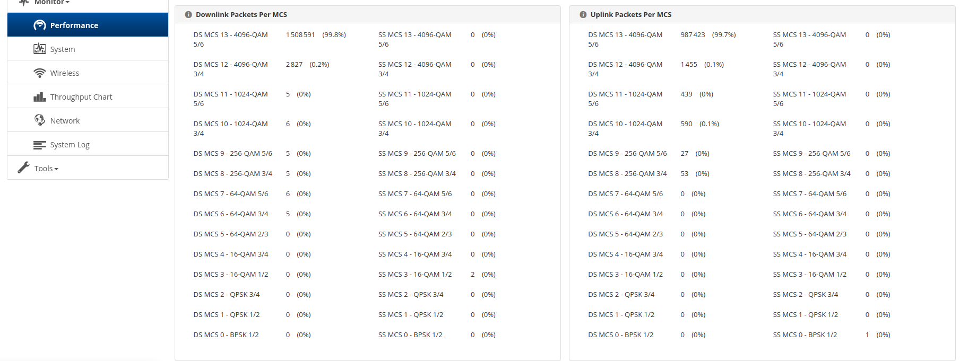
20 MHz channels, device stats: AP

Slide 18
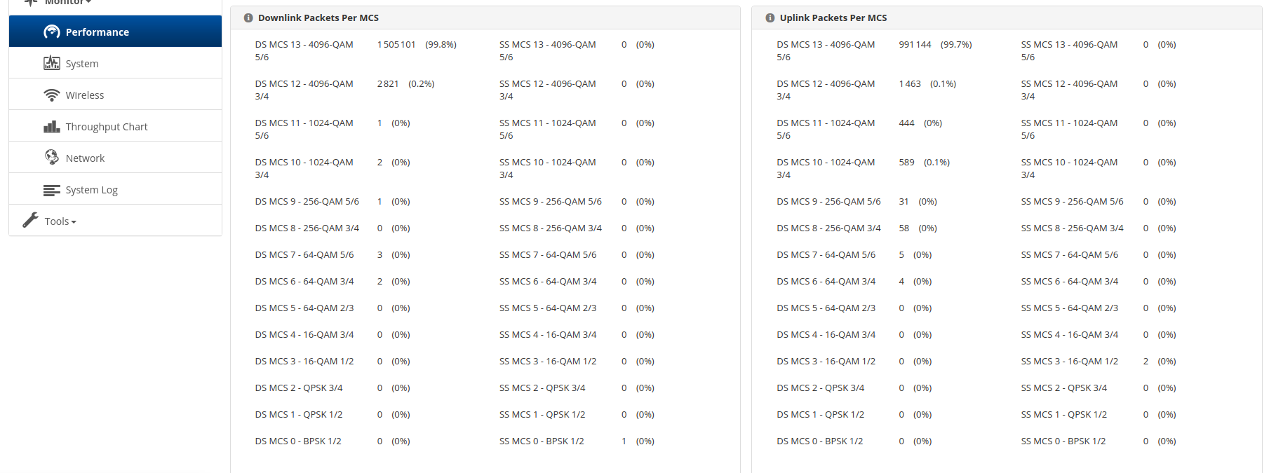
20 MHz channels, device stats: SM

Slide 19
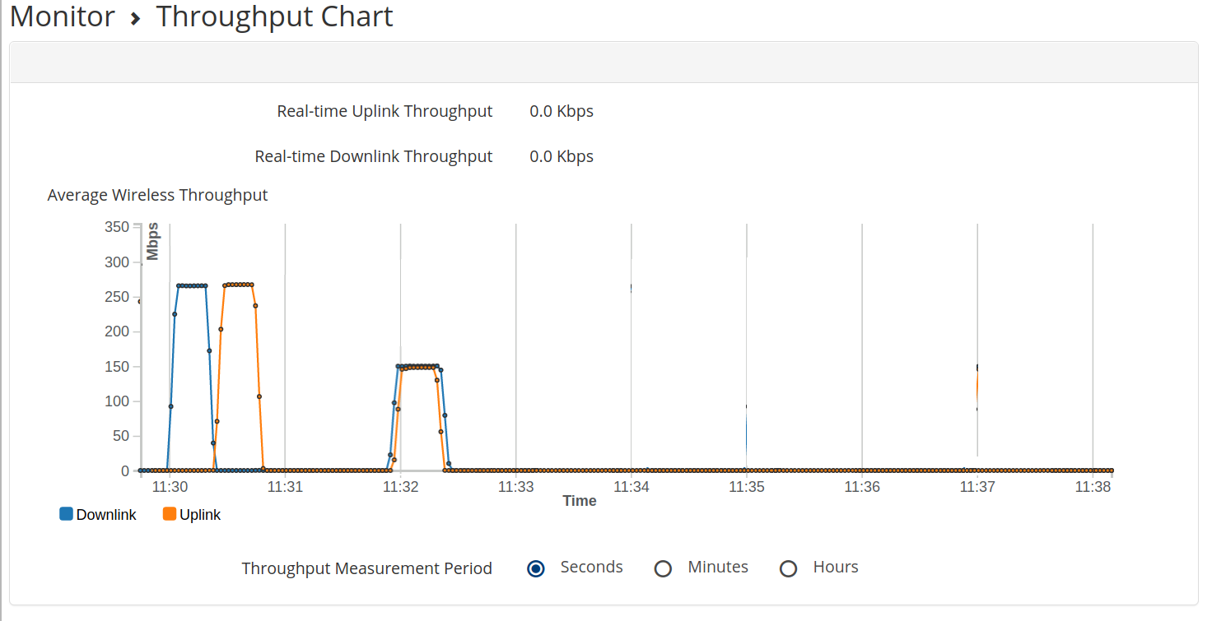
20 MHz channels, device performance: TPUT chart
DL up to 260 Mbit/s - UL up to 260 Mbit/s
DL + UL (bidi) up to 300 Mbit/s

Slide 20
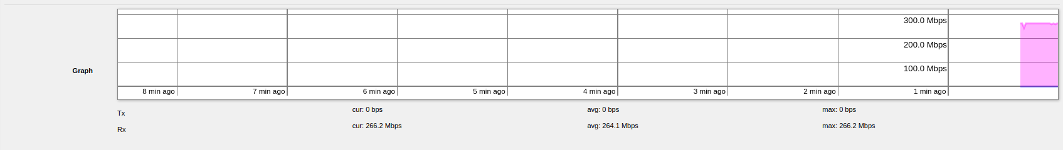
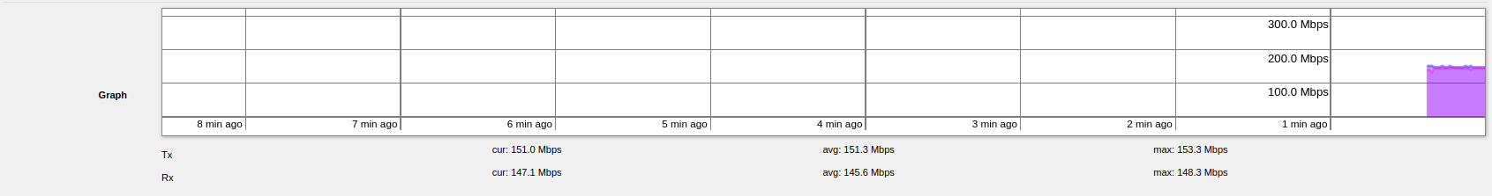
20 MHz channels, device performance: mikrotik generator
DL up to 260 Mbit/s - UL up to 260 Mbit/s
DL + UL (bidi) up to 300 Mbit/s

Slide 21
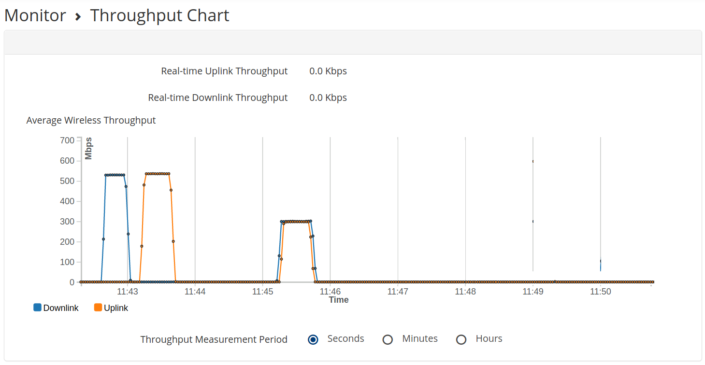
40 MHz channels, device performance: TPUT chart
DL up to > 500 Mbit/s - UL up to > 500 Mbit/s
DL + UL (bidi) up to 600 Mbit/s

Slide 22


40 MHz channels, device performance: mikrotik generator
DL up to > 500 Mbit/s - UL up to > 500 Mbit/s
DL + UL (bidi) up to 600 Mbit/s

Slide 23

80 MHz channels, device performance: TPUT chart
DL up to > 1.1 Gbit/s - UL up to > 1.1 Gbit/s
DL + UL (bidi) up to 1.25 Gbit/s

Slide 24


80 MHz channels, device performance: mikrotik generator
DL up to > 1.1 Gbit/s - UL up to > 1.1 Gbit/s
DL + UL (bidi) up to 1.25 Gbit/s

Slide 25

160 MHz channels, device performance: TPUT chart
DL up to 2.2 Gbit/s - UL up to 2.2 Gbit/s
DL + UL (bidi) up to > 2.5 Gbit/s

Slide 26


160 MHz channels, device performance: mikrotik generator
DL up to 2.2 Gbit/s - UL up to 2.2 Gbit/s
DL + UL (bidi) up to > 2.5 Gbit/s

Slide 27
Questions
+1-888-863-5250
cambiumnetworks.com

